Slide 1
Prepare a mail merge letter using the file Merit letter.doc as your Master and the Student Table.xlsx as the source data.
You will need to insert relevant fields from your data source in to the master document.
You will need to replace date with a field to display today’s date in the format DD/MM/YYYY.
Add your name as the originator of the letter.
Proofread and spell check the letter.
Merge the letters to those students who have achieved 100 or more merit points.
Add a minimum of three features to the mail merge master document to suit a professional letter.
Create a slide master template in a Presentation software using the three features used in the mail merge document. Include slide numbers and your name in the slider footer.

Slide 2
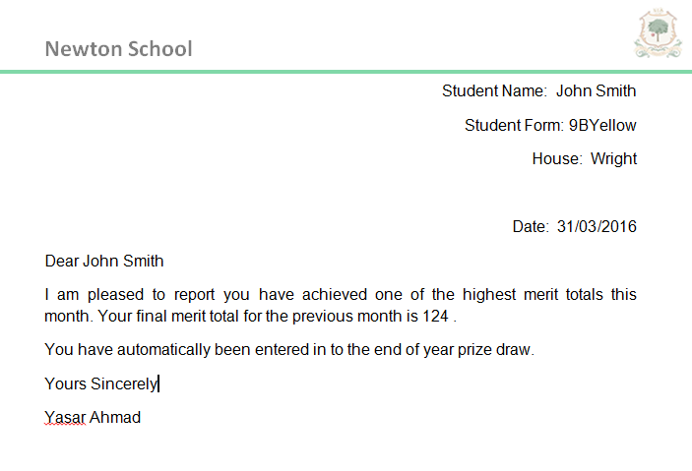
Mail Merged Letter

